Slide 1
Smart India Hackathon 2020 IT_Chill_Hai!
Great Learning: Smart Education GL32
Identifying if a Student is paying attention during Live Webinars

Slide 2
Overview
The project encompasses that there be an Instructor who will live stream a Video for the Students to view in browsers, while simultaneously resolving doubts in Real Time through audio channels as they enter the queue in time, all of which are reflected onto the Browser DashBoard.
All client side operations are in-browser while the streams and analytic data are transferred through WebRTC onto the Flask Server for Attention Detection Computations to run on. The computations have been achieved through the Python3 package dlib while the Mathematical Calculations are performed using SciPy. These are then prompted by Javascript accordingly to both the clients and also safekept for future analytical purposes.

Slide 3
What we have completed so far
We have already secured all operations related to processing of Visual Media. This gives us a fair and reliable idea of whether or not the student is paying attention by looking for Visual Cues on the Student’s face through WebCam.
We have also created an independent platform for Video transfer onto the server than for using a Pre-Existing Service in order to obtain the video for Detection in Real Time and not simply stream it.

Slide 4
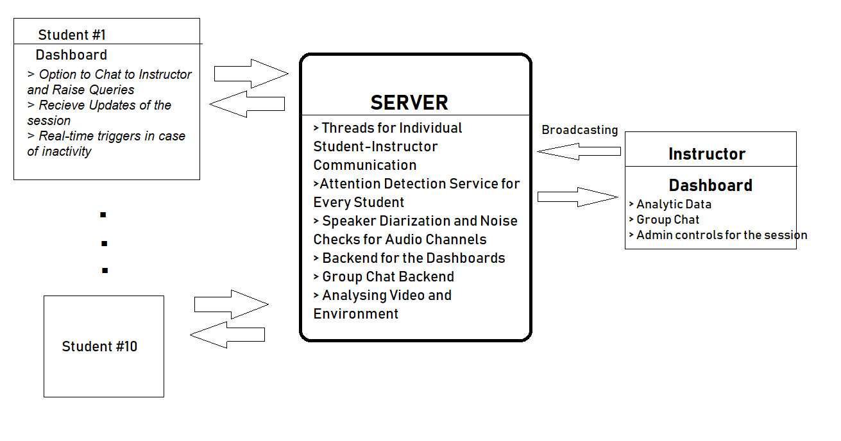
Design Flow

Slide 5

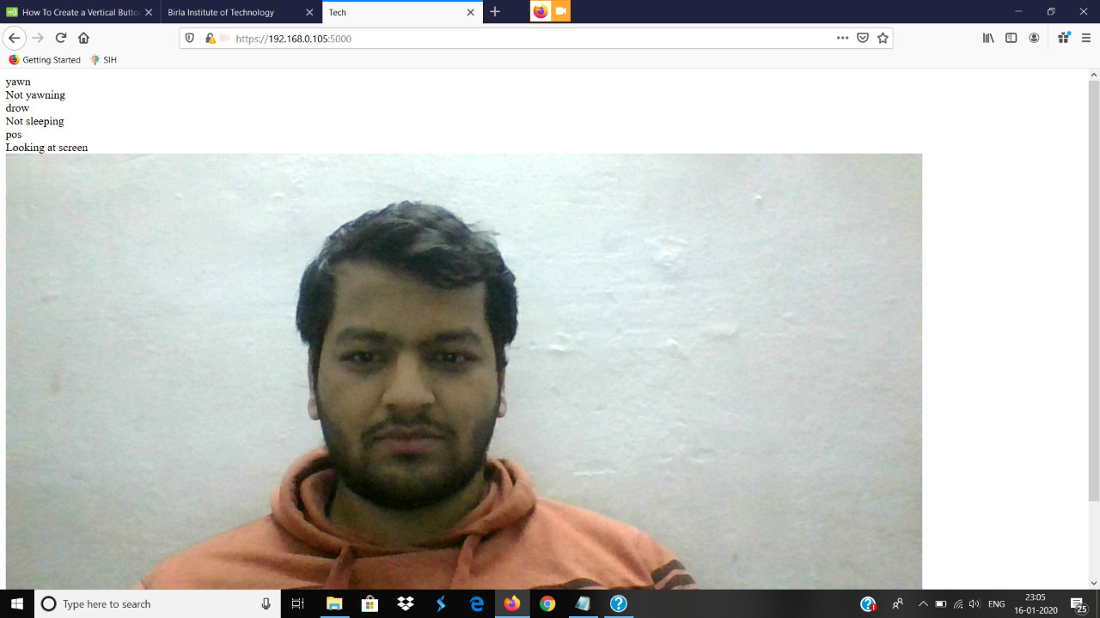

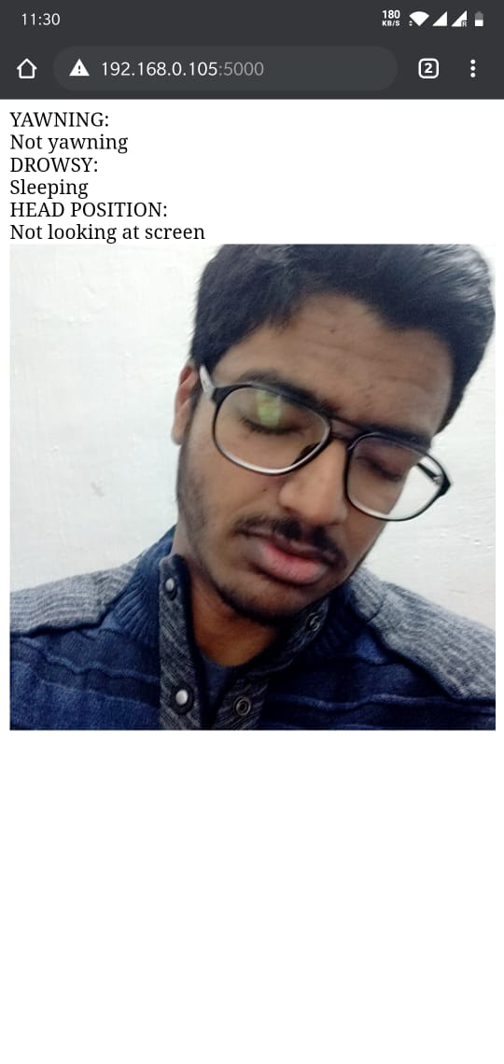
Attention Detection through Visual Media

Slide 6
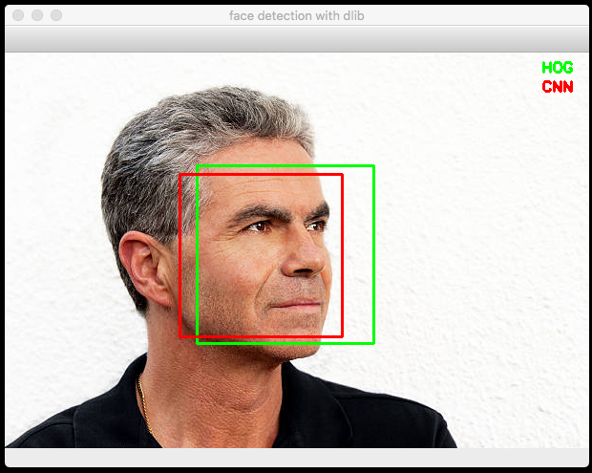
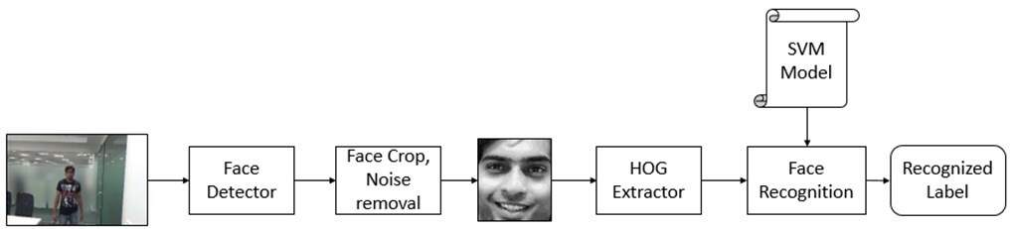
Face Detection
Since first and foremost idea is to look for the user on the screen , we have used frontal_face_detector() from dlib python package which works on of histogram oriented gradients (HOG) and linear SVM to detect the user's face on the screen. Our focus was on detecting frontal faces so we didn't use a CNN based detector as it can detect faces at different angles isn't required here.

Slide 7
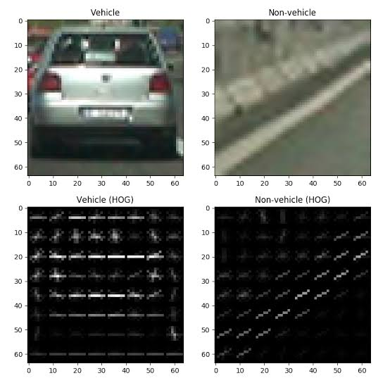
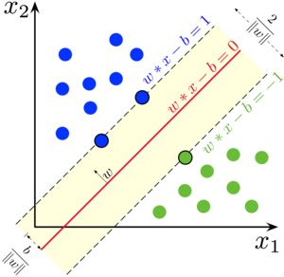
HOG
Linear SVM
The histogram of oriented gradients (HOG) is a feature descriptor used in computer vision and image processing for the purpose of object detection. The technique counts occurrences of gradient orientation in localized portions of an image.
In machine learning, support-vector machines are supervised learning models with associated learning algorithms that analyze data used for classification analysis.

Slide 8
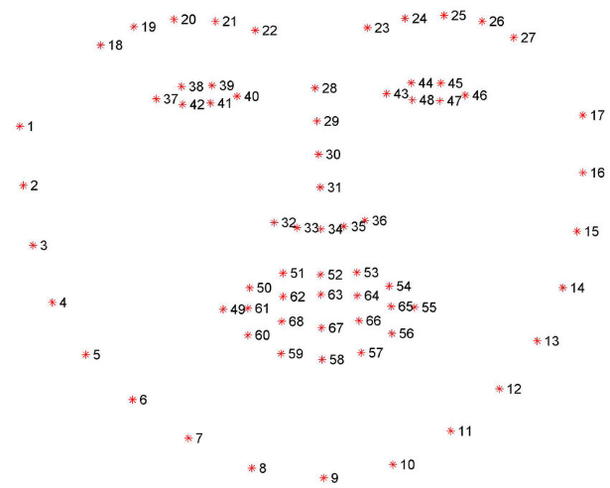
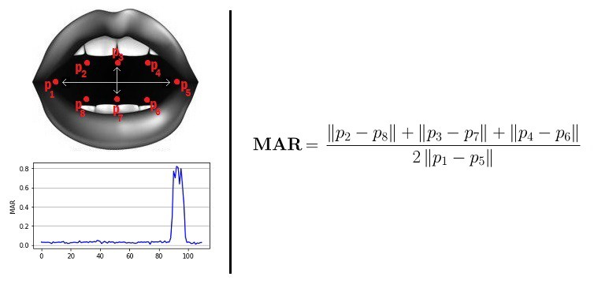
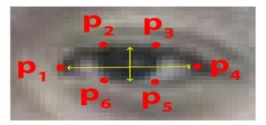
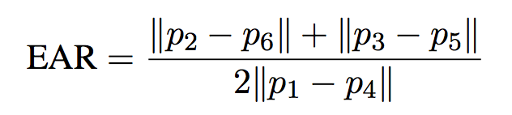
By observation if EAR <0.2 we can say user's gonna sleep
Detecting Sleeping and Yawning
By observation we fount if MAR <0.35 we can say user's taking a yawn.
Detecting Sleeping and Yawning : In case the student is bored or not interested in paying attention to online session he will feel sleepy and yawn often. So to detect these two factors we have used opencv2 and with the help of 68_landmarks on face given by shape_predictor we extract the eyes and mouth points .

Slide 9
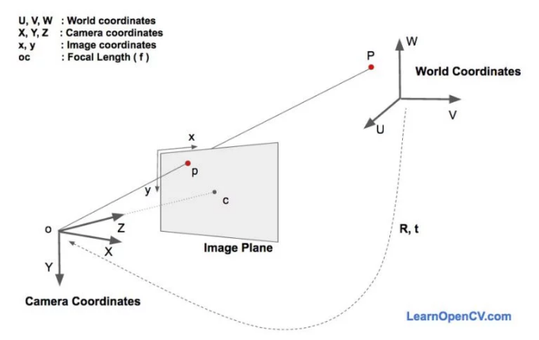
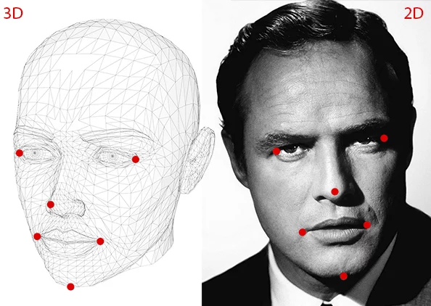
Detecting Head Position:
Now so far we haven't considered about user looking away from screen . This is a challenging task as we have to correlate the 3D Face of person to its 2D projections on image. To get an estimation of pose of head we build a relationships with 2D points thats basically the 68_landmarks on face with the new points on face as 3D coordinates according pre-defined world coordinates i.e. Tip of Nose : (0,0,0) , Chin : ( 0.0, -330.0, -65.0) ..etc.

Slide 10
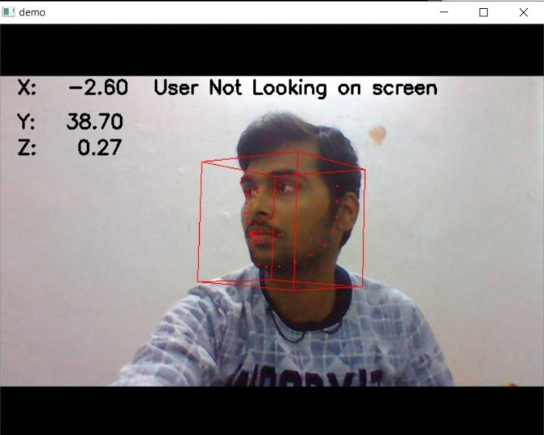
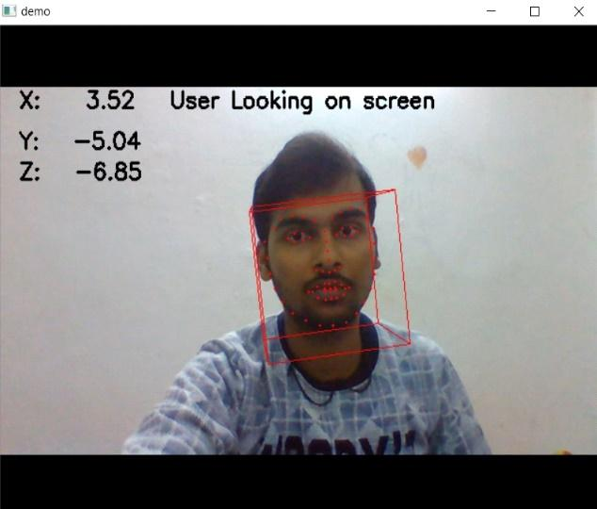
Thus we come across solving a Perspective -n- point (PnP) which takes image and object coordinates as input and returns a rotational and translational vectors for 3D estimation. Finally we calculate euler angles of the vectors in all three directions X, Y and Z .
We have used opencv2 and dlib for getting coordinates and calculating euler angles respectively.
Observation: With the help of "Y" euler angle we observed that when -20<Y<30 degrees the head position is almost on screen and when Y goes beyond that range we can say user is looking away from the screen and not paying attention.

Slide 11
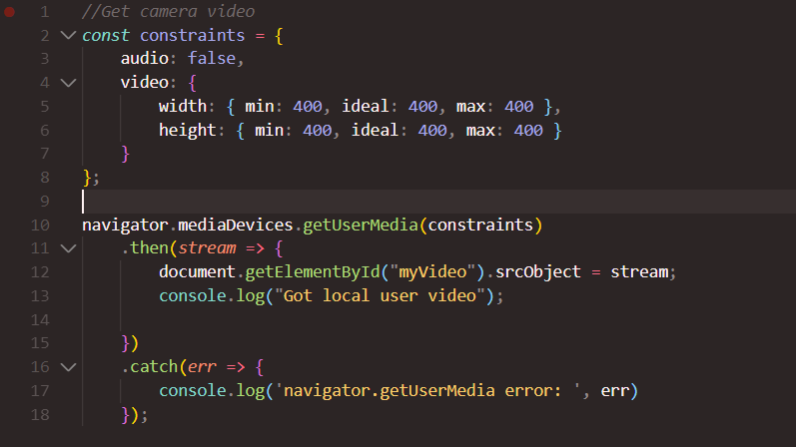
Application of WebRTC:
With Web Real-Time Communication (WebRTC), modern web applications can easily stream audio and video content to millions of people. We have applied its API: getUserMedia( ) here to access the WebCam as per the Constraints provided. We have eliminated the Audio Input for demonstration. Thereafter the stream generated in this JS script is transferred to the Flask Server by making a POST request onto the FaceAction API through an XMLHTTPRequest in JSON format.

Slide 12
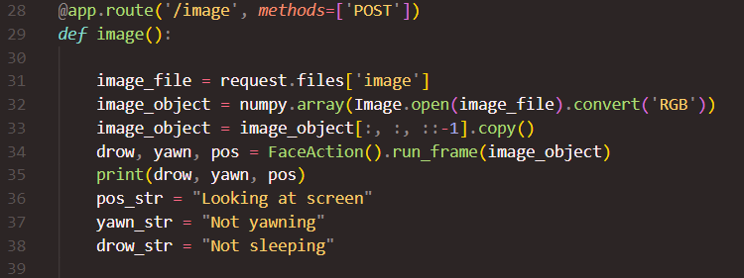
FaceAction API:
This is an API we defined which integrates the Attention Detection Models discussed until now. This is utilized in performing all computational activities and transmit it to the browser.

Slide 13
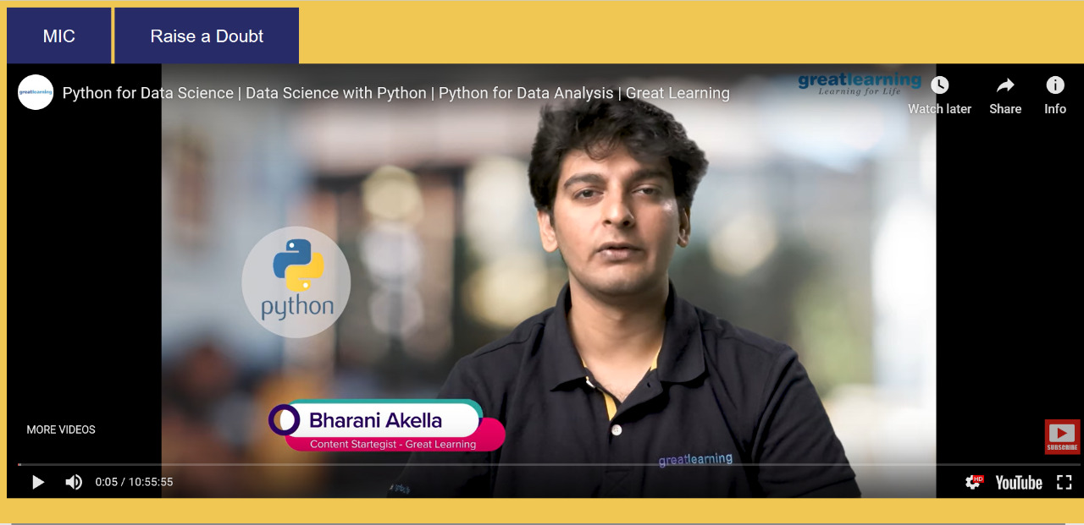
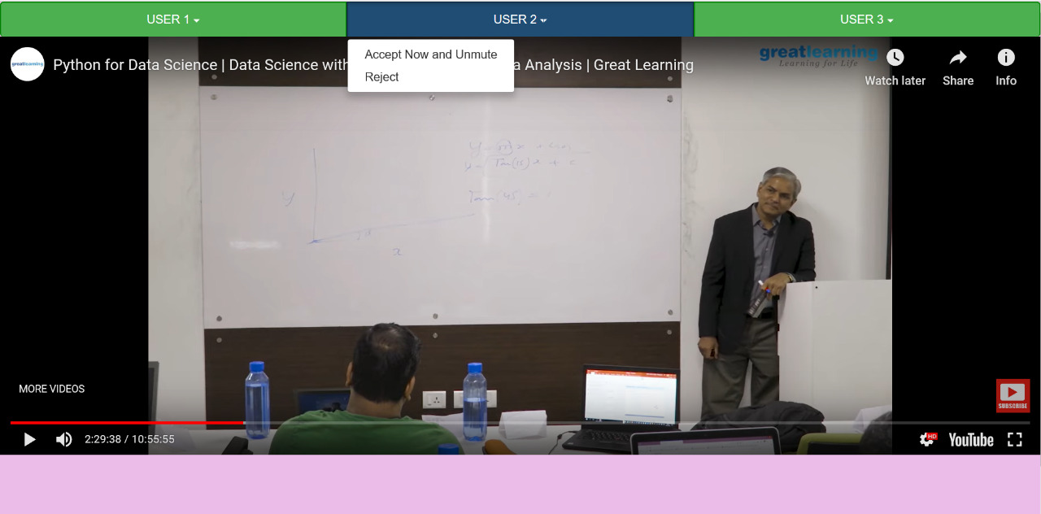
Sample Dashboards :

Slide 14
TODOS:
Implementing real time audio transmission between participants and the instructor during the session through EnableX API.
Adding event-listeners and enhancing dashboards for both instructors and participants.
Determining one-way vs two-way interaction between instructor and participant. The various recorded data such as interaction time, number of attentive participants at any moment, most engaging doubt and general effectiveness of the two way communication, will be provided in real time as well as neatly provided after the session. This would help the instructor to better model his/her lectures.
Analysing FFT models for noise detection.

Slide 15
TEAM Members:
Swapnil Ghosh
Kushal Srivastava
Ishaan Gupta
Anshuman Srivastava
Srishti Binwani
Tanmay Sinha

